Slide 1
Origins of a Meme
Justin Whitlock
November 29, 2016

Slide 2
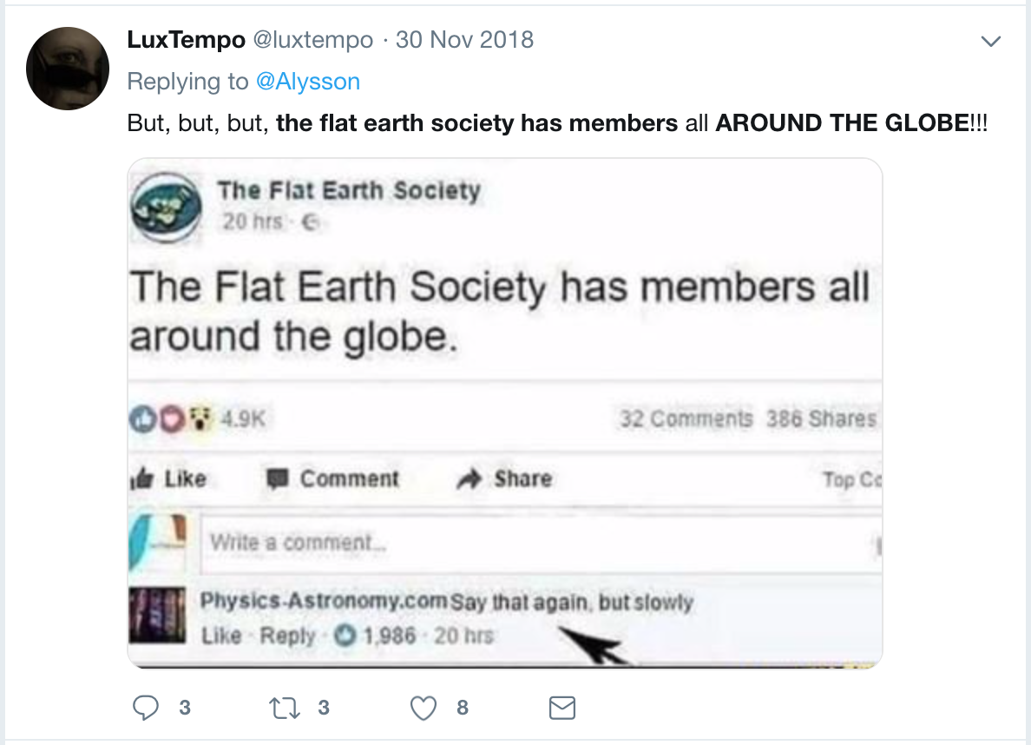
If you haven’t seen it...
https://web.archive.org/web/20190320150855/https:/twitter.com/luxtempo/status/1068654270919004161

Slide 3
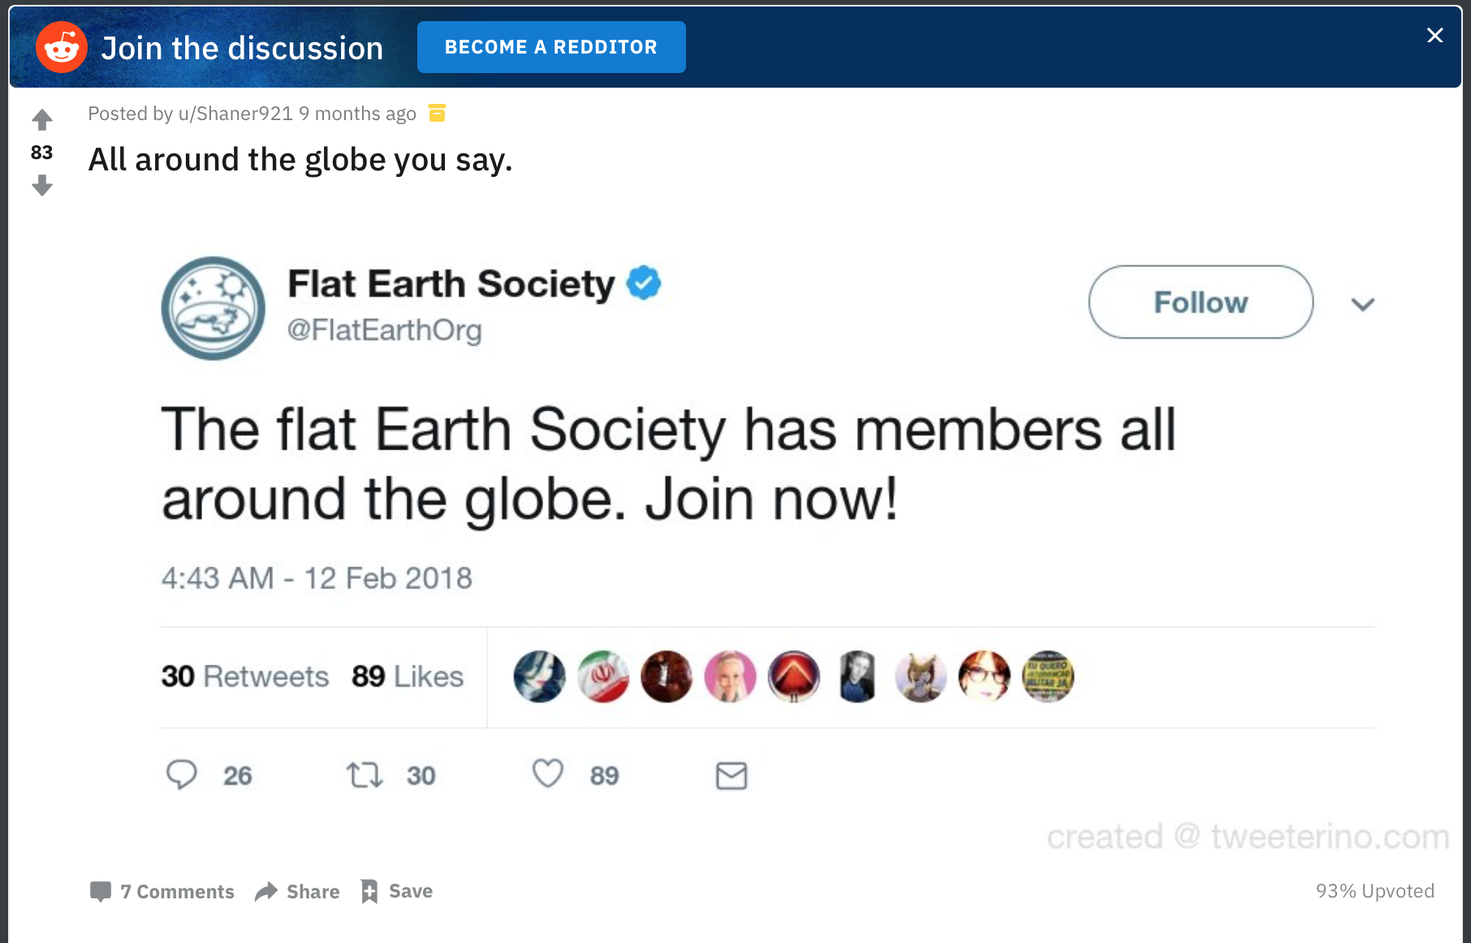
Different version, obviously faked; Tweeterino.com
https://web.archive.org/web/20190320182032/https://www.reddit.com/r/FlatEarthMemes/comments/8qhmit/all_around_the_globe_you_say/

Slide 4
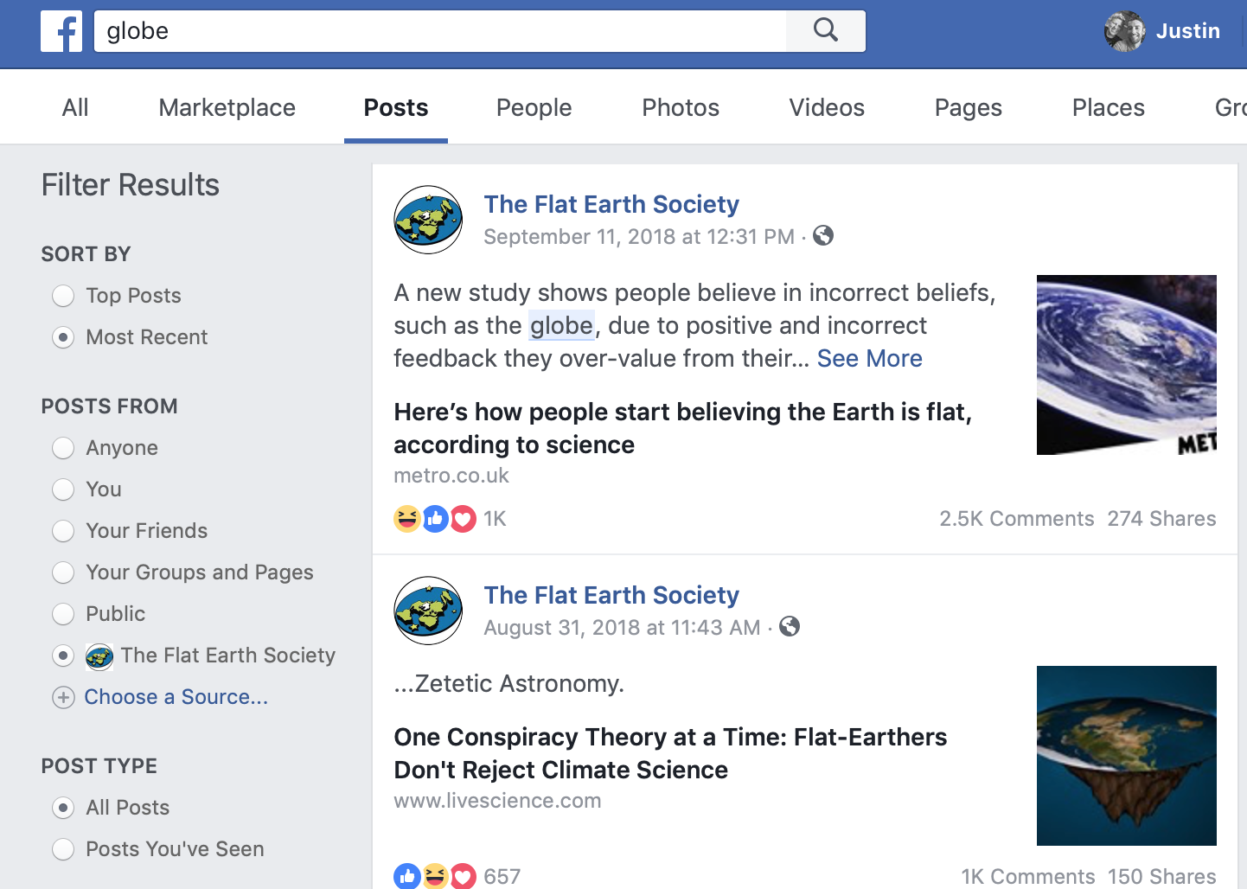
Facebook Search returns only 7 posts with “globe”
http://bit.ly/2ThjjV3

Slide 5
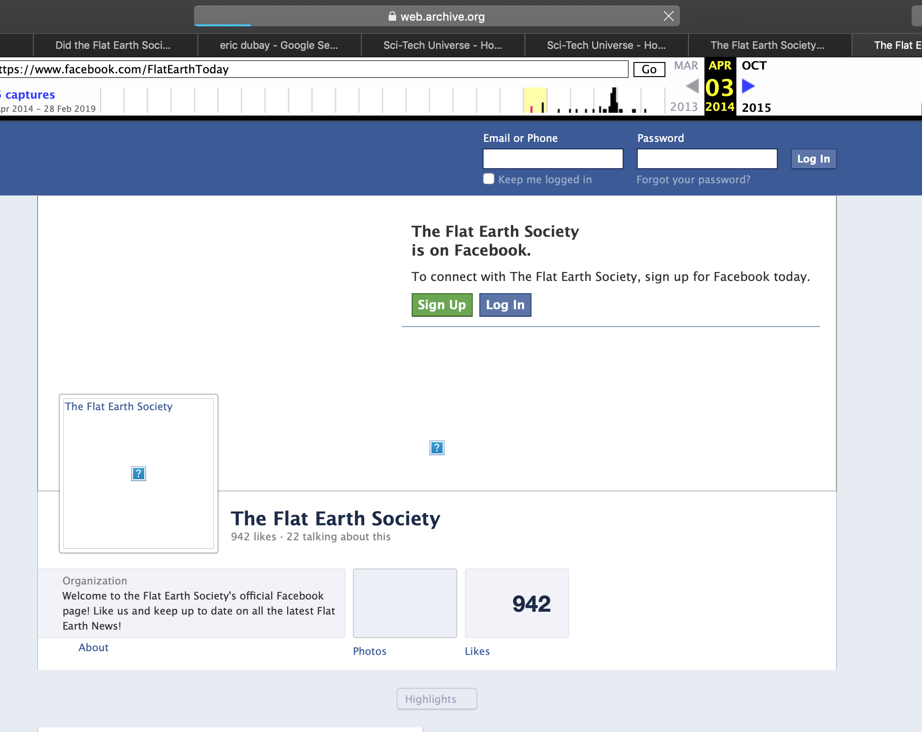
Facebook in archive is weird; Pages reload over&over
https://web.archive.org/web/20140403051341/https://www.facebook.com/FlatEarthToday

Slide 6
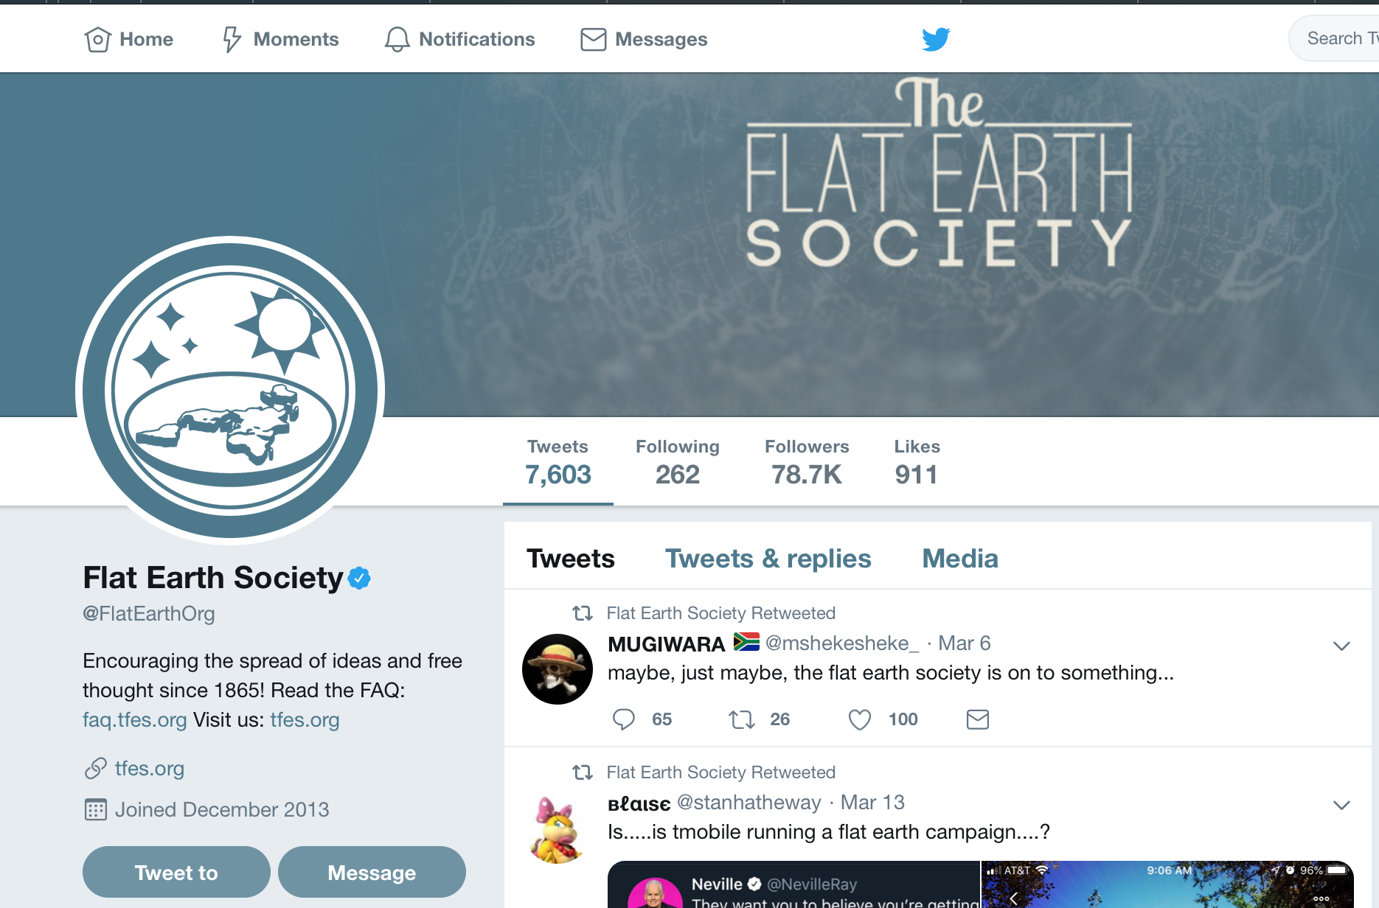
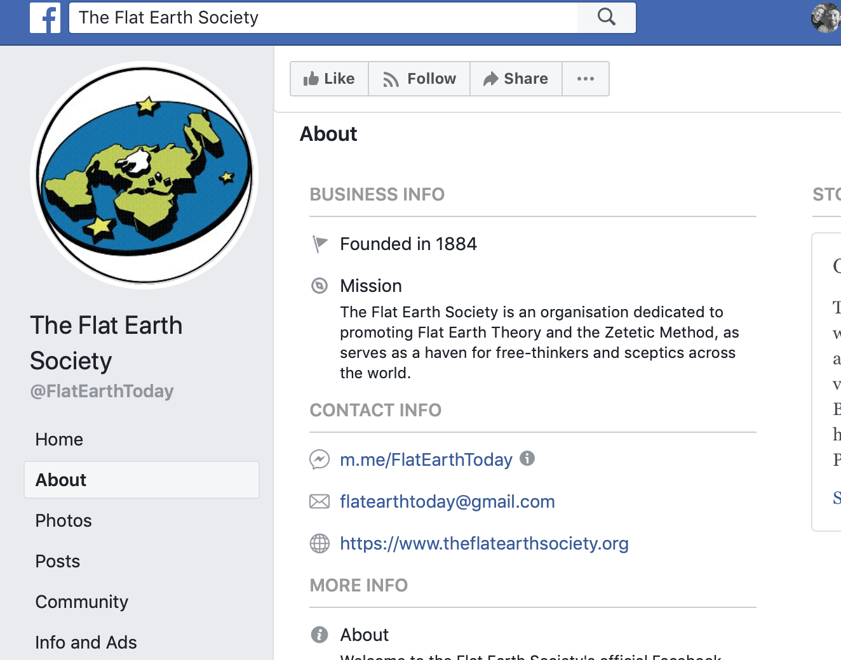


Twitter account seems unassociated; different webpage
https://twitter.com/FlatEarthOrg https://www.facebook.com/pg/FlatEarthToday

Slide 7
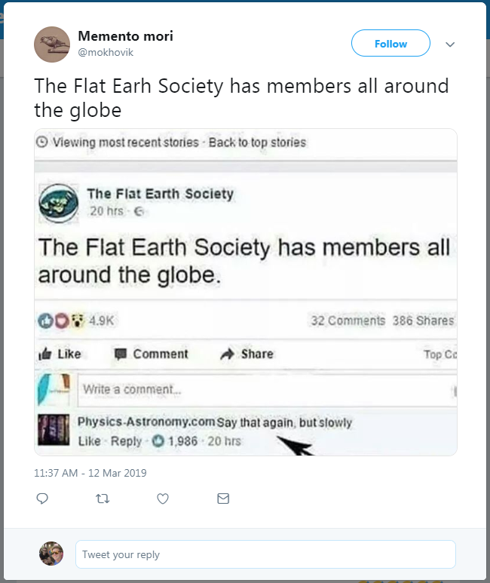
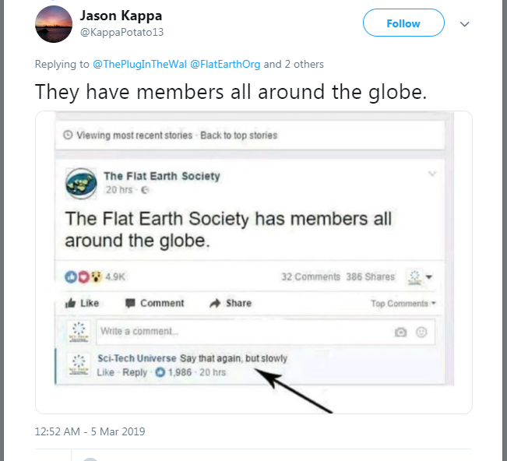
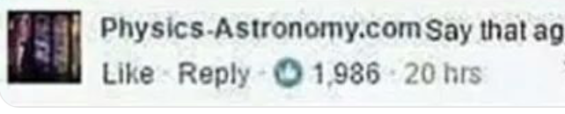

Two images, different commenters, same info
https://web.archive.org/web/20190320150121/https:/twitter.com/mokhovik/status/1105538317515395073
https://web.archive.org/web/20190320150224/https:/twitter.com/KappaPotato13/status/1102854478628237312

Slide 8
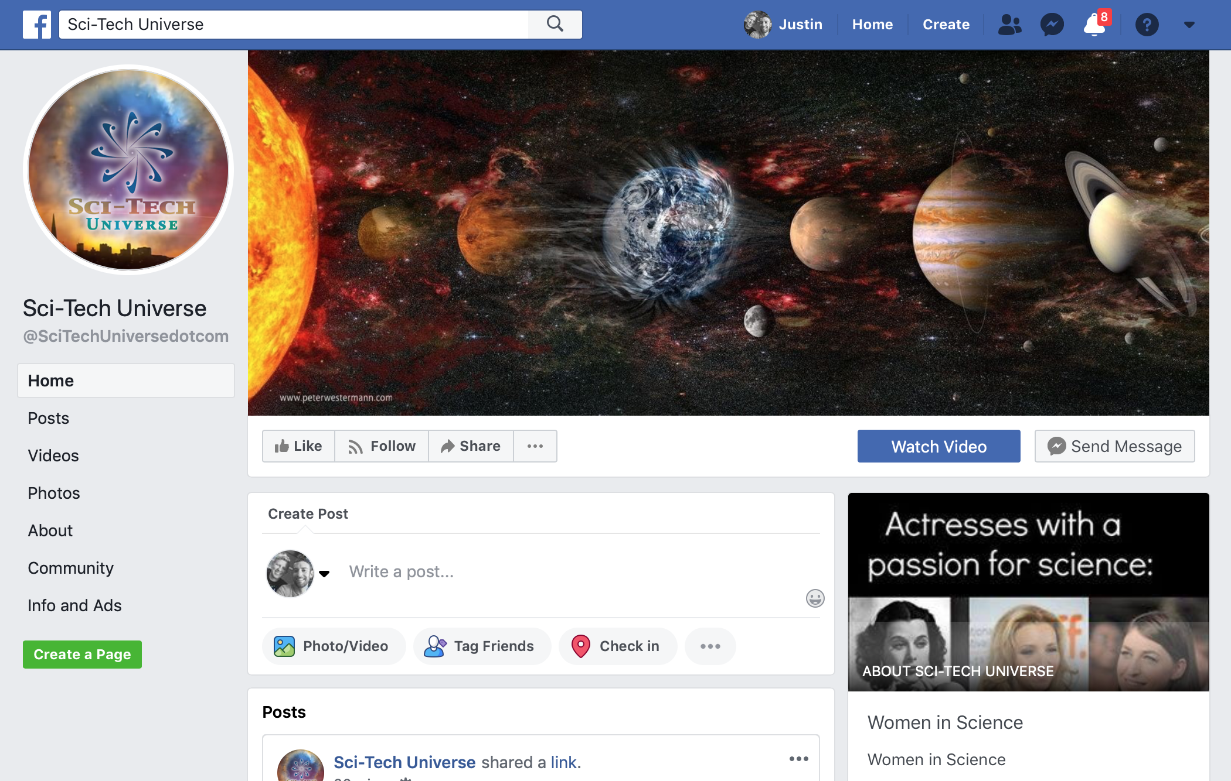
Sci-Tech Universe on Facebook
https://www.facebook.com/SciTechUniversedotcom

Slide 9
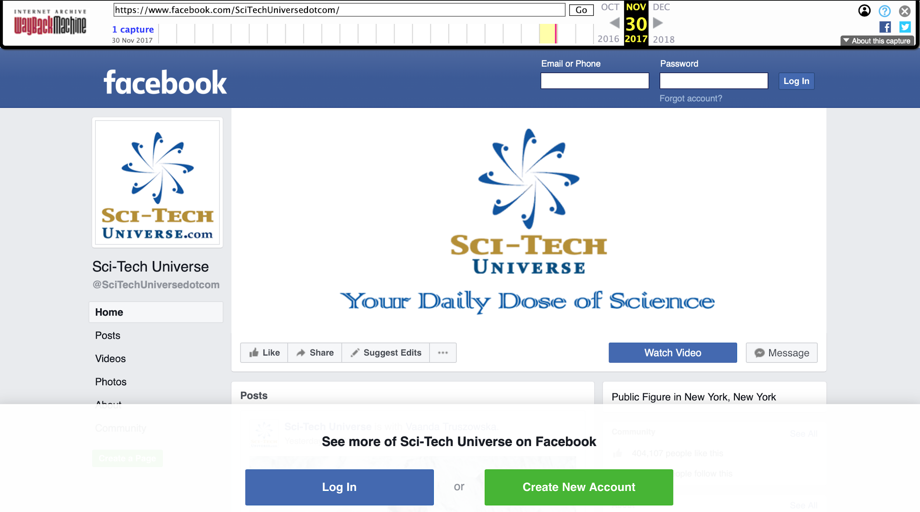
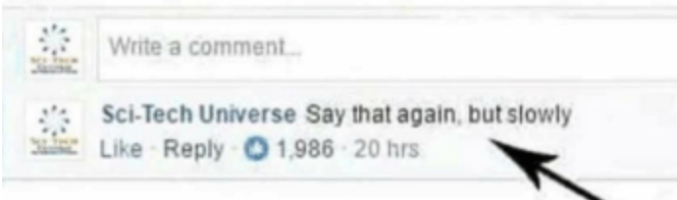
Same logo in the wayback machine in 2017
https://web.archive.org/web/20171130233930/https://www.facebook.com/SciTechUniversedotcom/

Slide 10
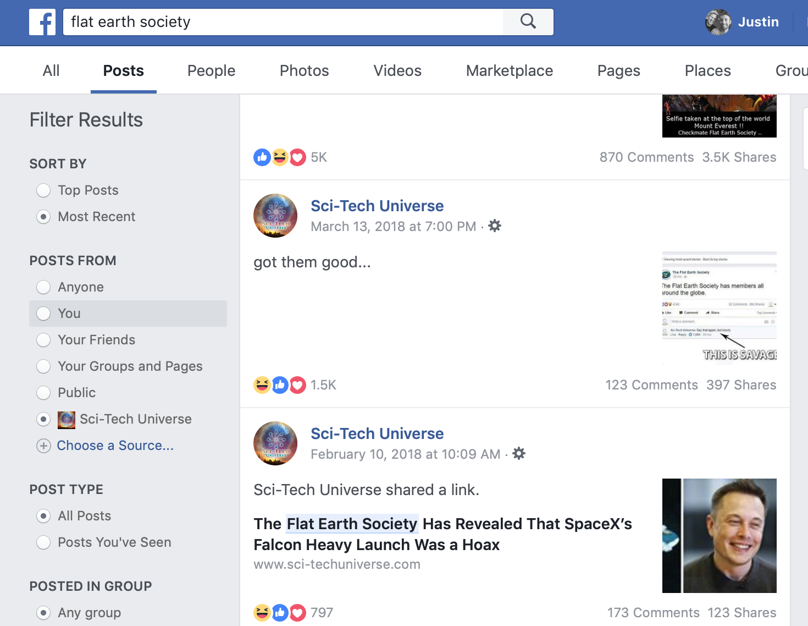
Search Sci-Techs posts
http://bit.ly/2Tgh2tu

Slide 11
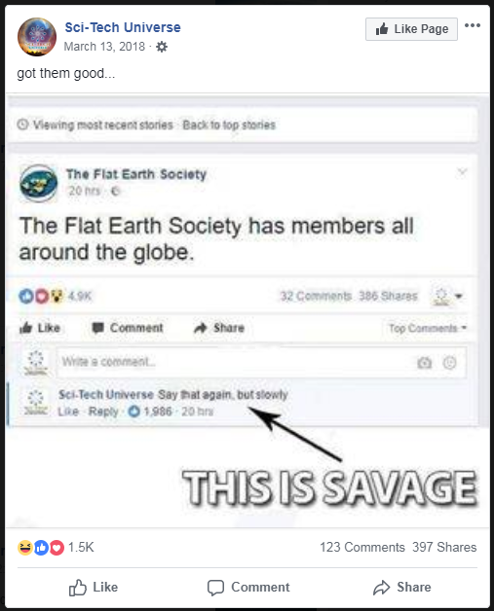
Search on Sci-techs page, shows up in 2018
Unlike Twitter, individual facebook posts are not archivable in WayBack machine.
https://www.facebook.com/SciTechUniversedotcom/photos/a.1684536875145778/1983784358554360/?type=3&theater

Slide 12
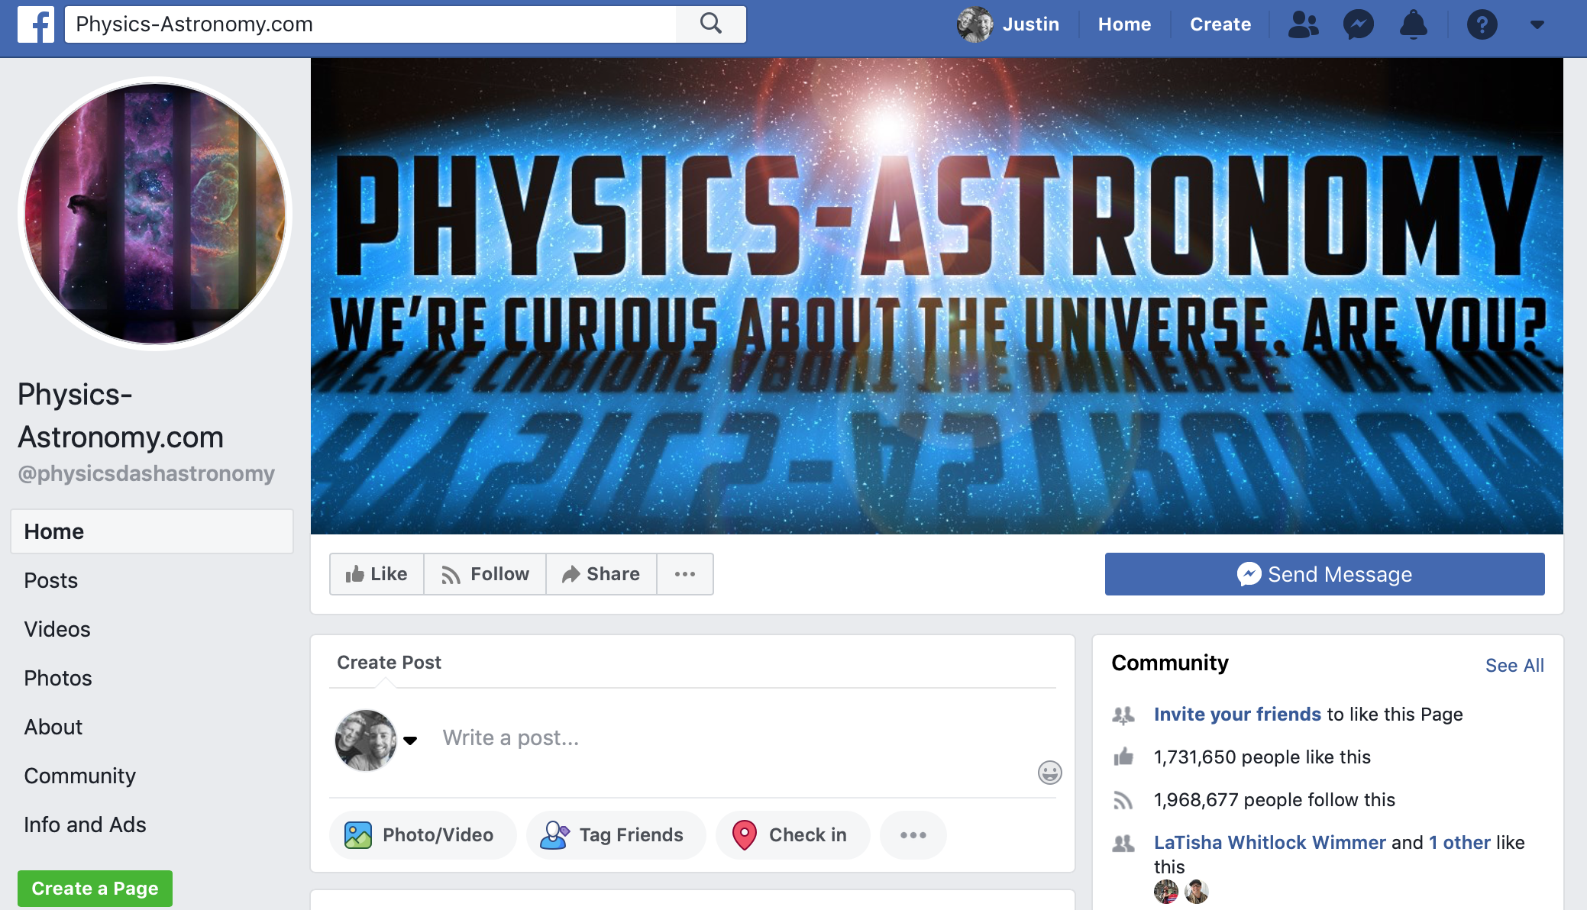
Physics astronomy on Facebook
https://www.facebook.com/physicsdashastronomy/

Slide 13
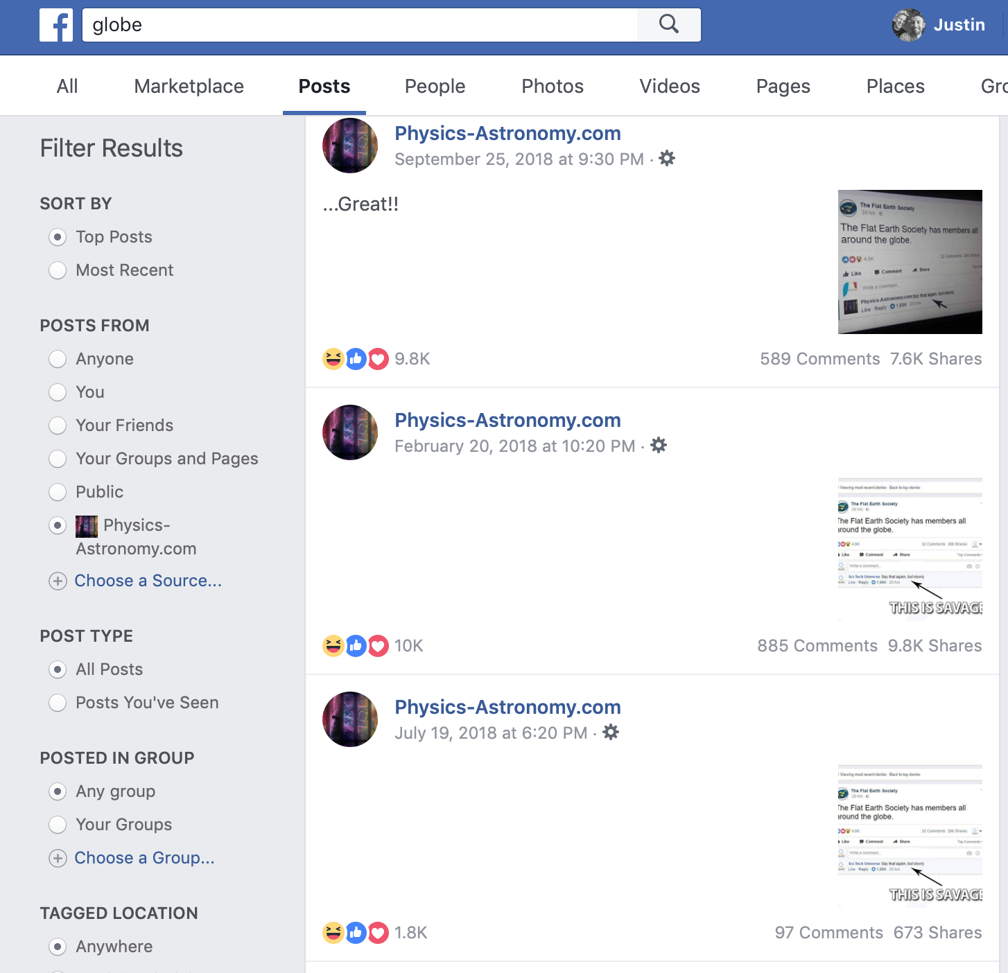
Facebook search turns up 3 posts
http://bit.ly/2Y9YJda

Slide 14
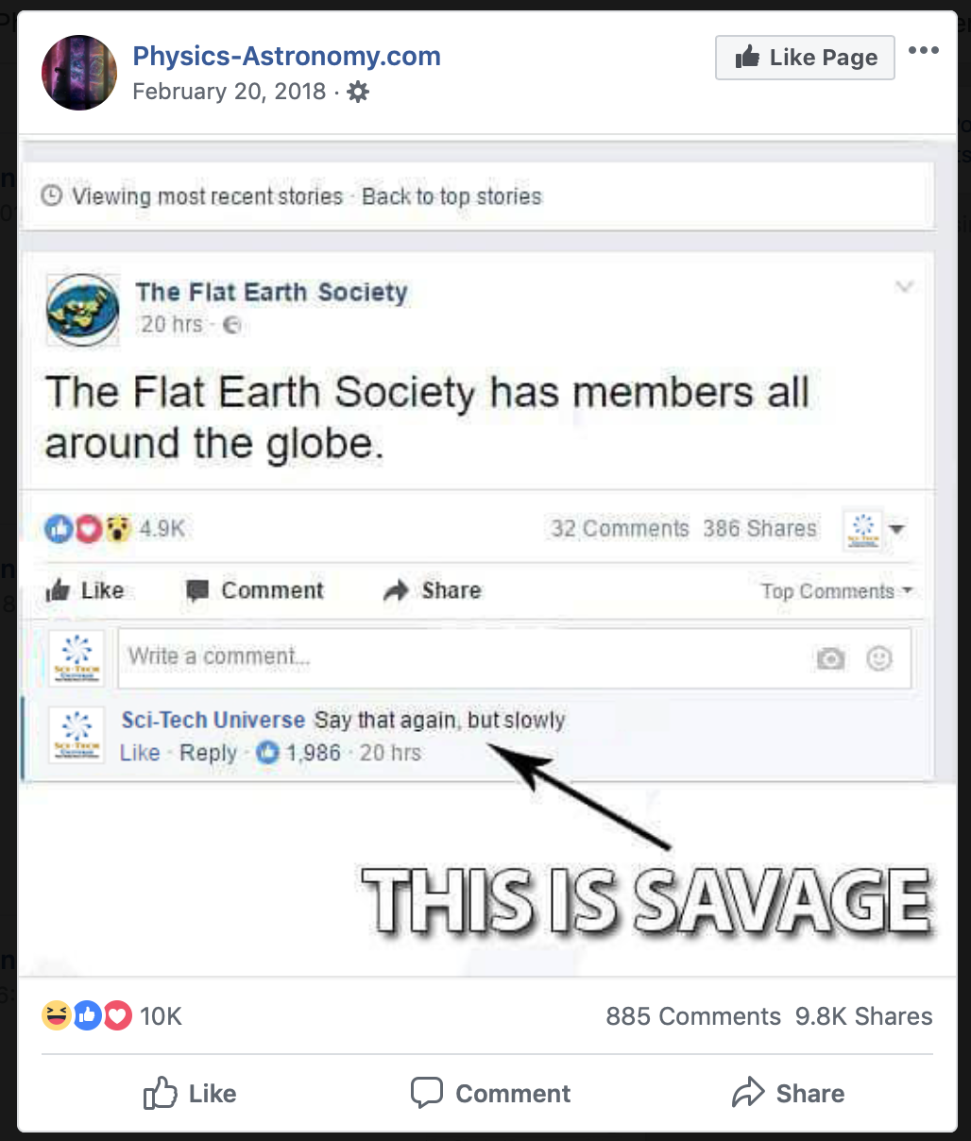
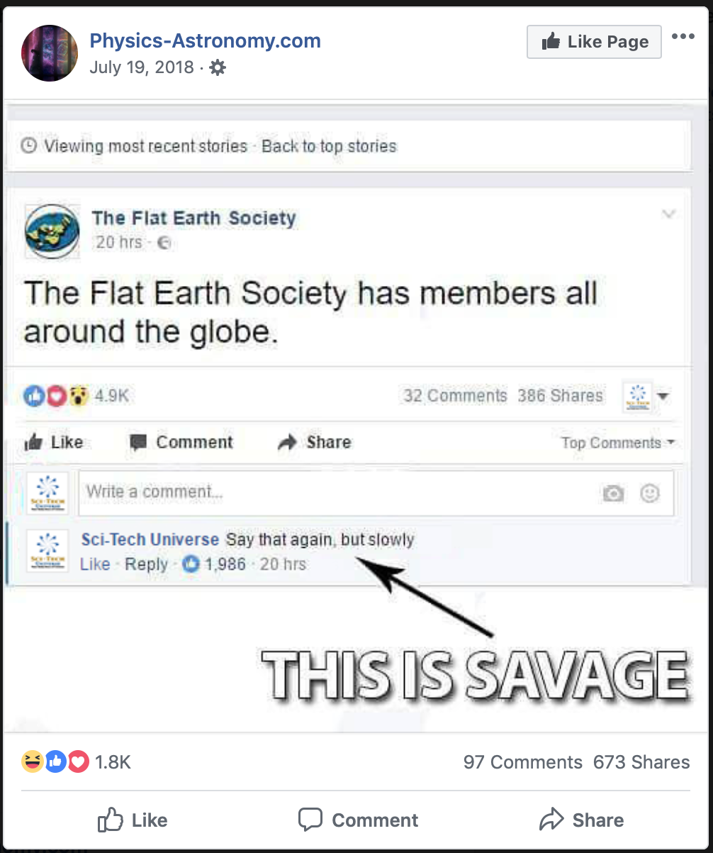
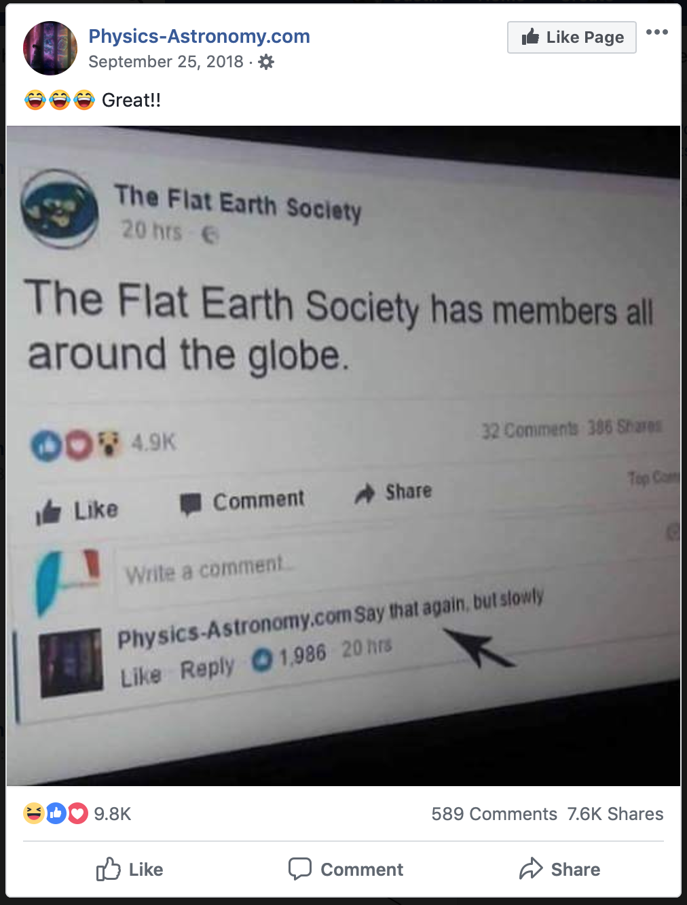
First 2 reference a different site
http://bit.ly/2uhnm9V http://bit.ly/2Ofr50Z http://bit.ly/2CwzFUu

Slide 15
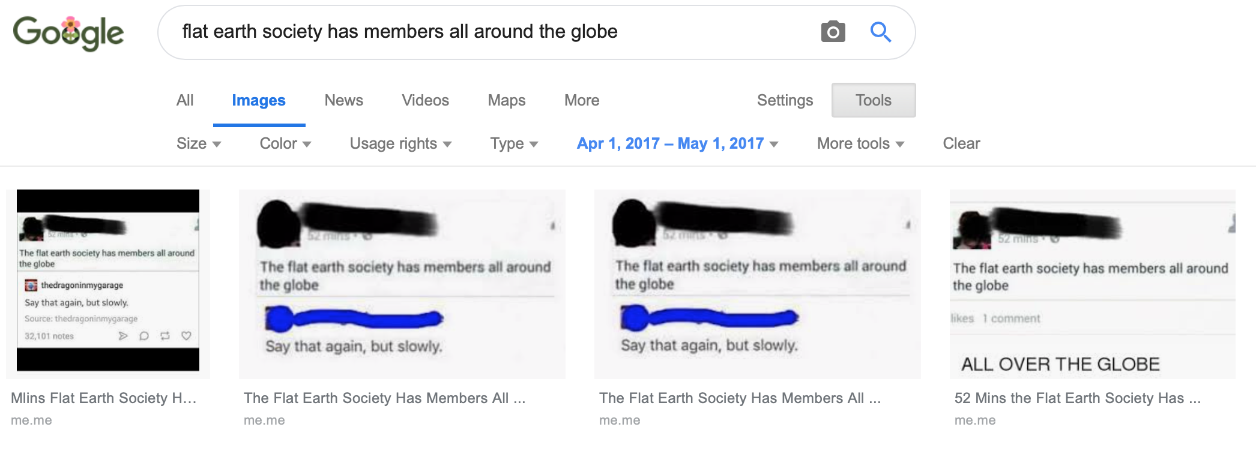
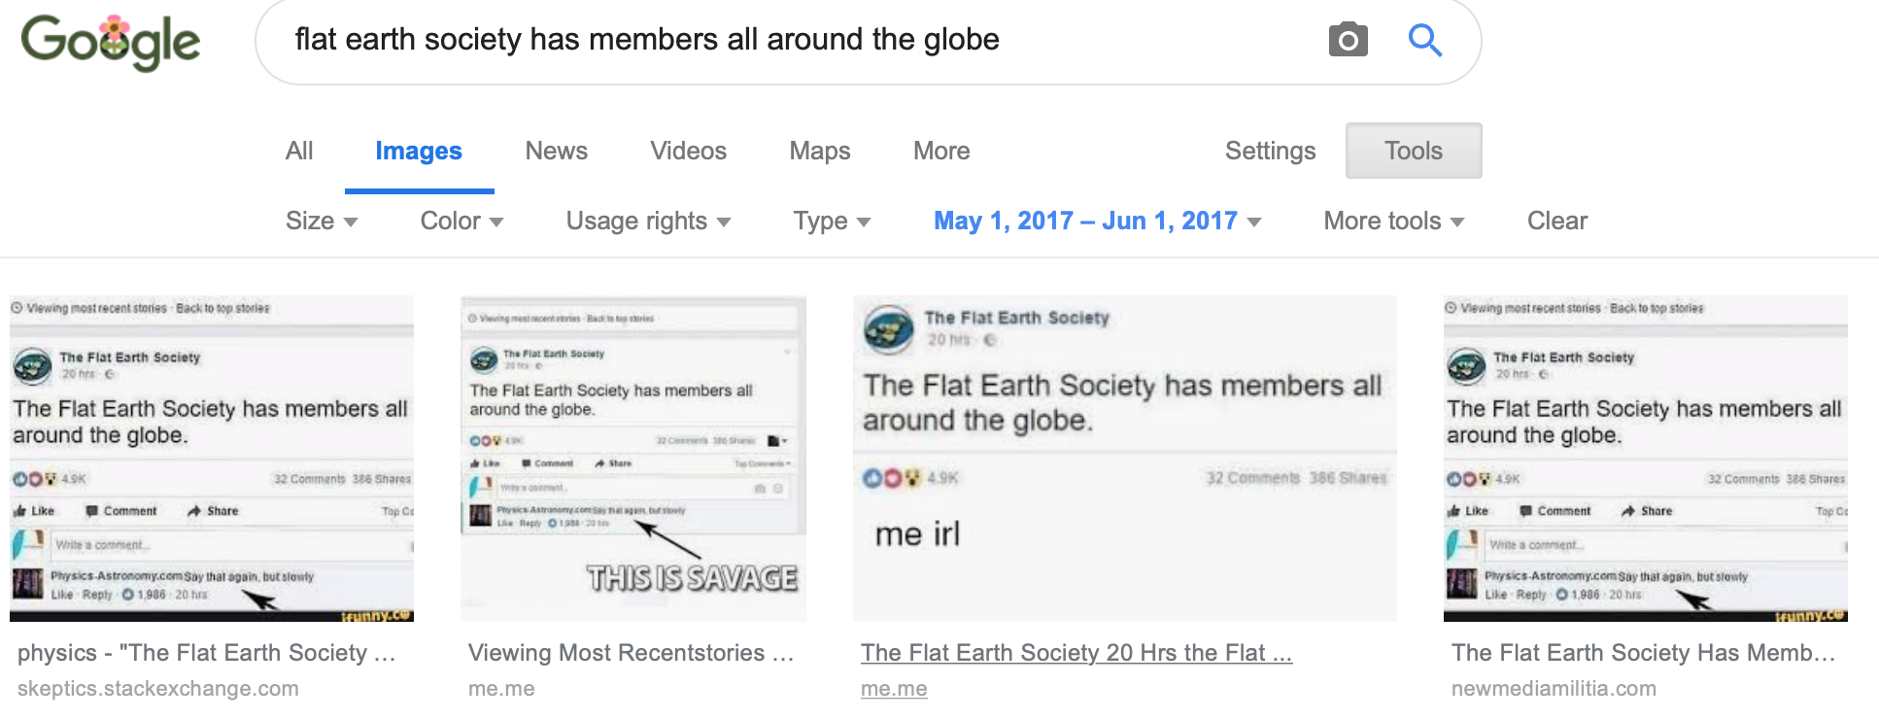
Flat Earth Society Meme doesn’t show up until May 17

Slide 16
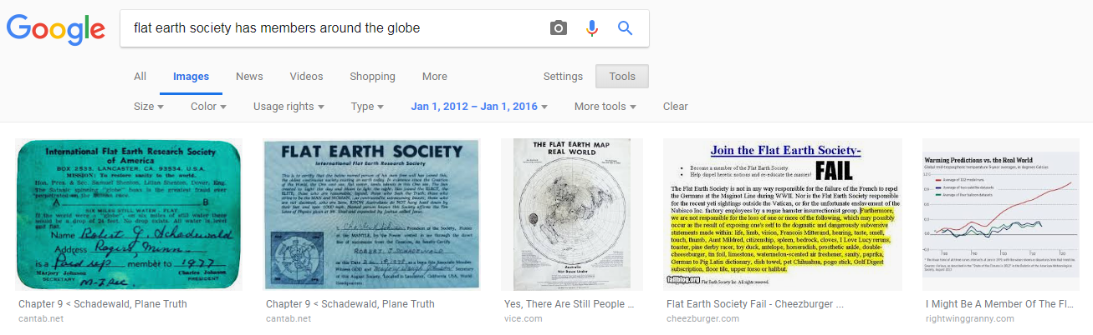
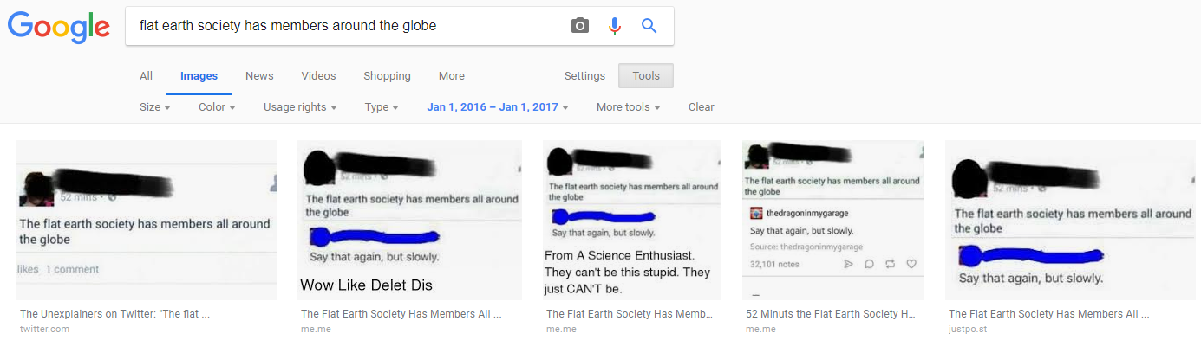
Meme first shows up as a top item in 2016
https://bit.ly/2Tdr52w
https://bit.ly/2TaOFfX

Slide 17
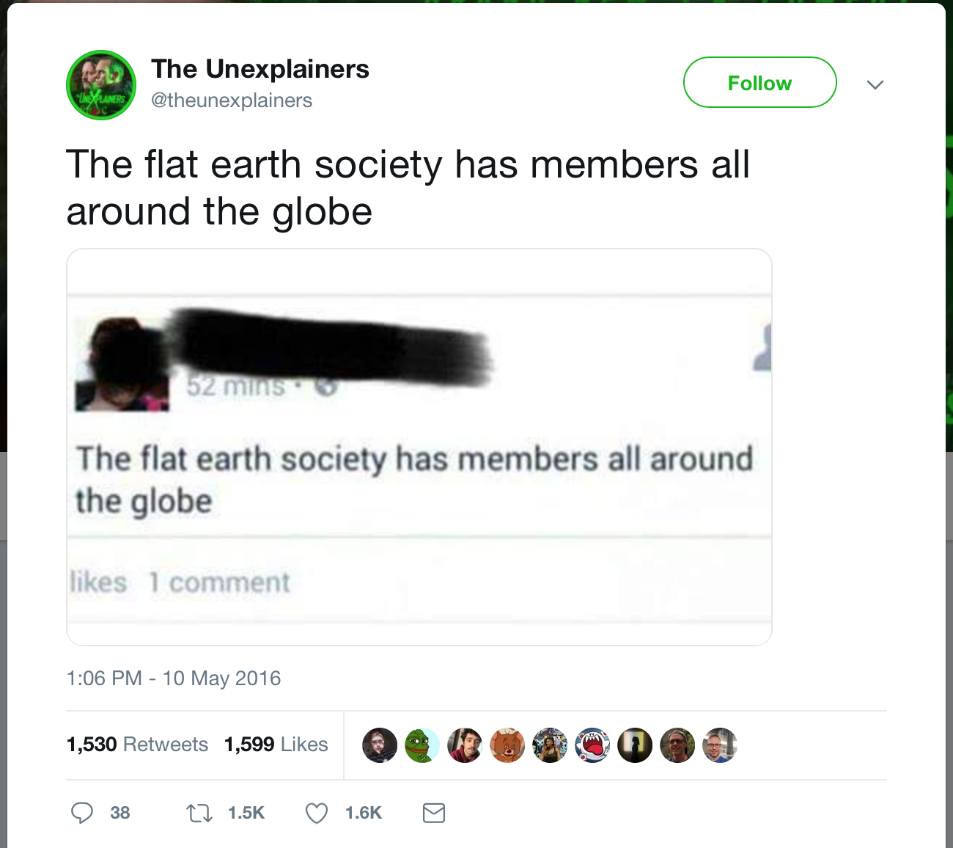
It’s not from Flat Earth Society
https://web.archive.org/web/20190320163149/https:/twitter.com/theunexplainers/status/730126930192826368

Slide 18
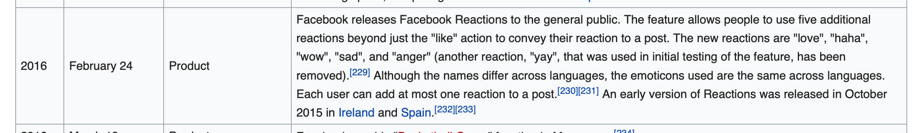
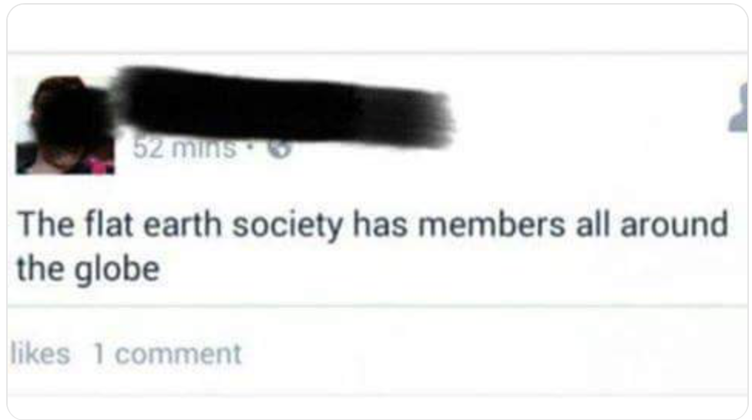
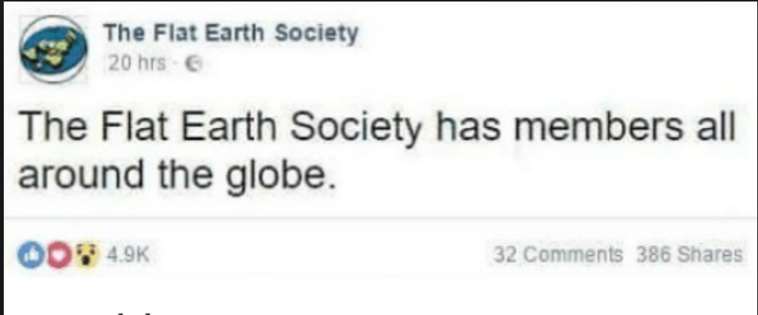
Facebook changed their likes bar 24 Feb 16
https://en.wikipedia.org/wiki/Timeline_of_Facebook

Slide 19
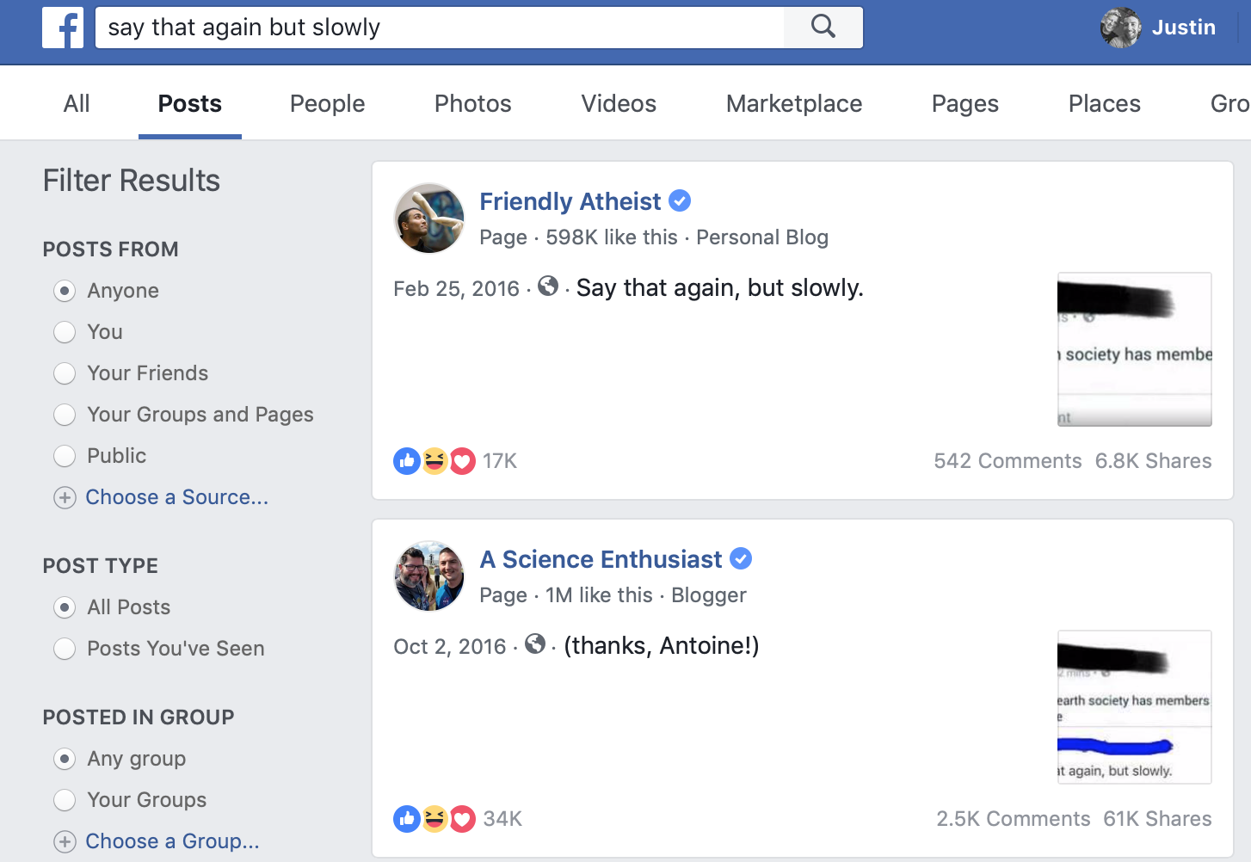
Facebook Search in 2016
http://bit.ly/2HJBBfA

Slide 20
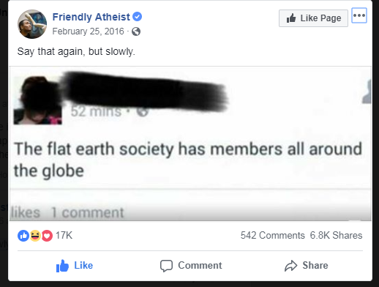
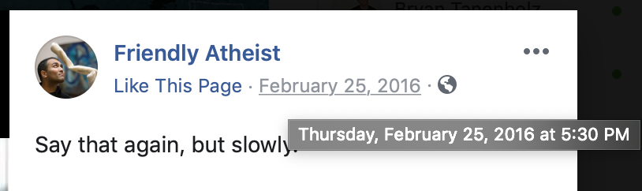
Earliest appearance on Facebook 25 Feb 16
https://www.facebook.com/friendlyatheist/photos/a.10152839688055080/10156600581265080/?type=3

Slide 21
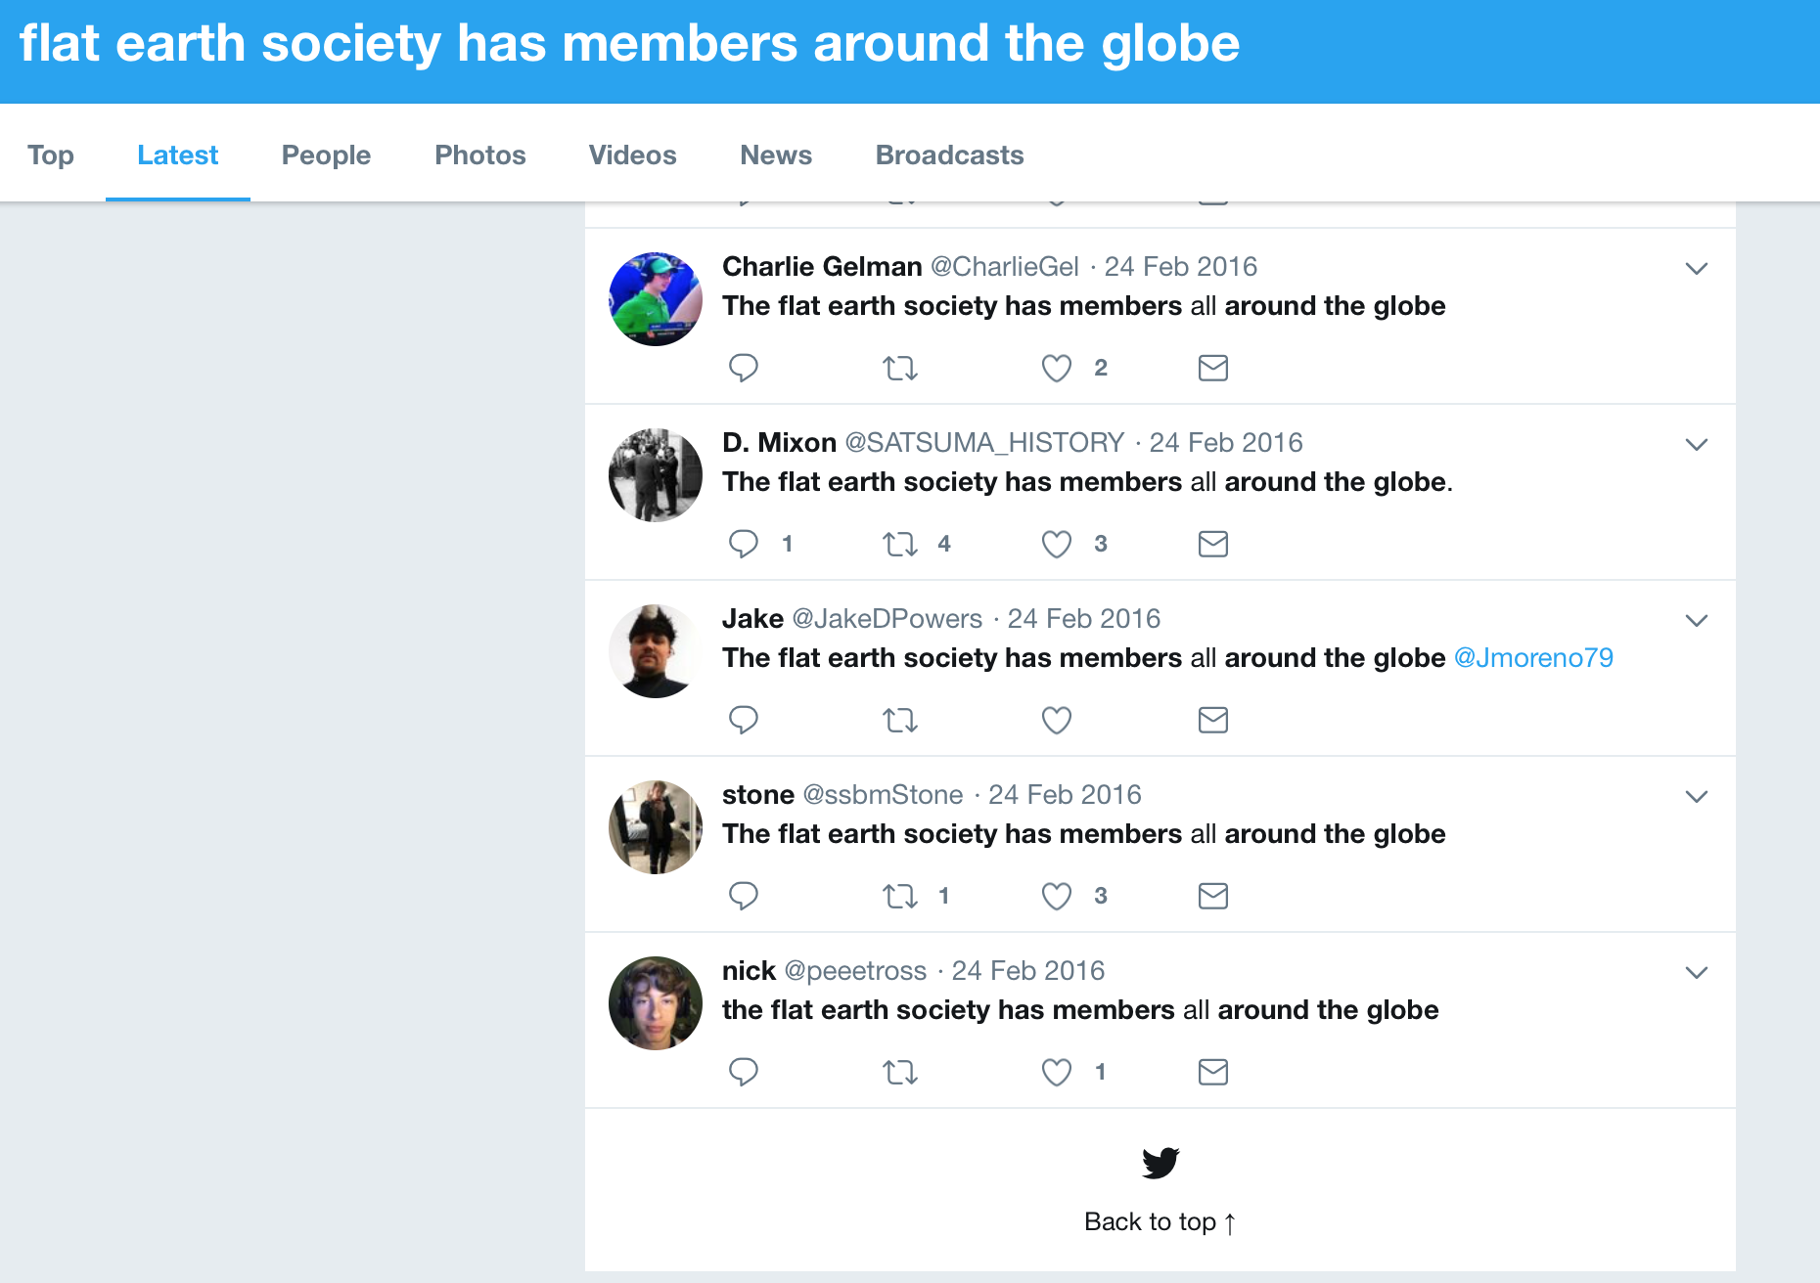
Twitter search results begin 24 Feb 2016
http://bit.ly/2WaEjib

Slide 22
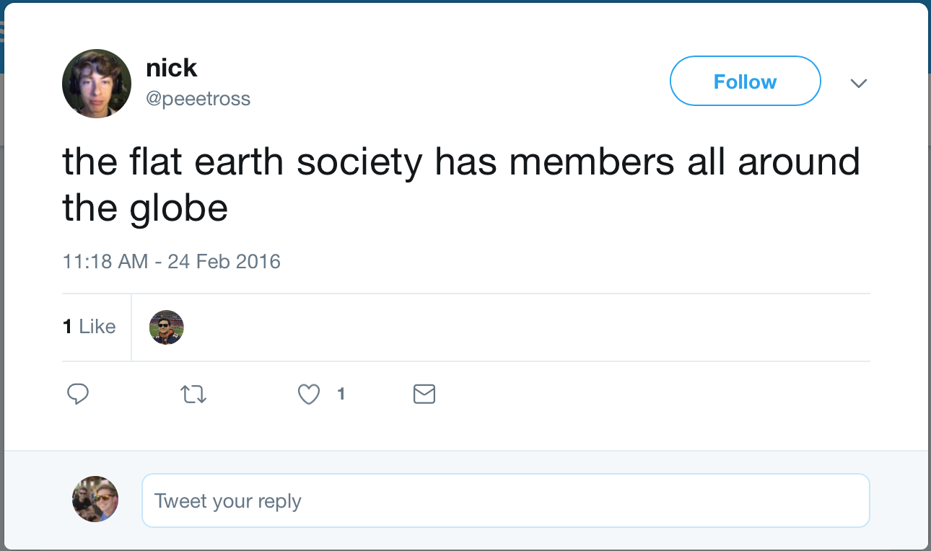
Earliest Tweet on Twitter
https://web.archive.org/web/20190320175244/https:/twitter.com/peeetross/status/702573339383095296

Slide 23
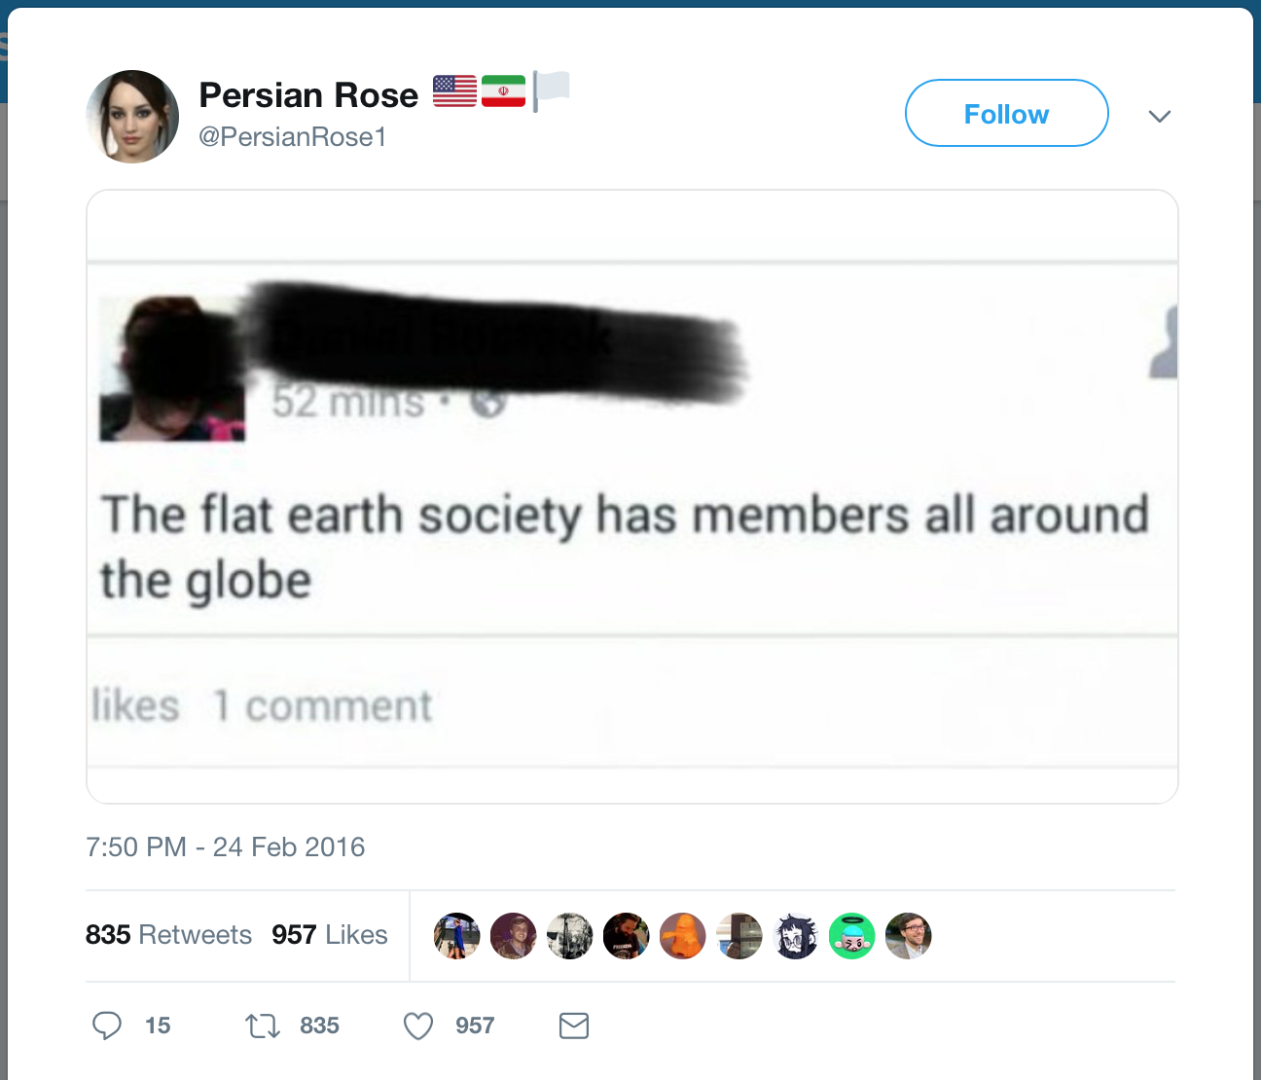
Earliest appearance of screen shot on Twitter 25 Feb 16
https://web.archive.org/web/20190320163806/https:/twitter.com/PersianRose1/status/702702085662449664

Slide 24
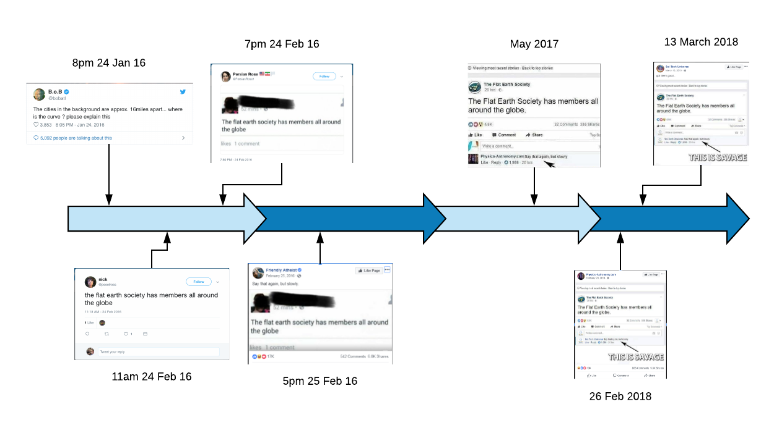

Slide 25
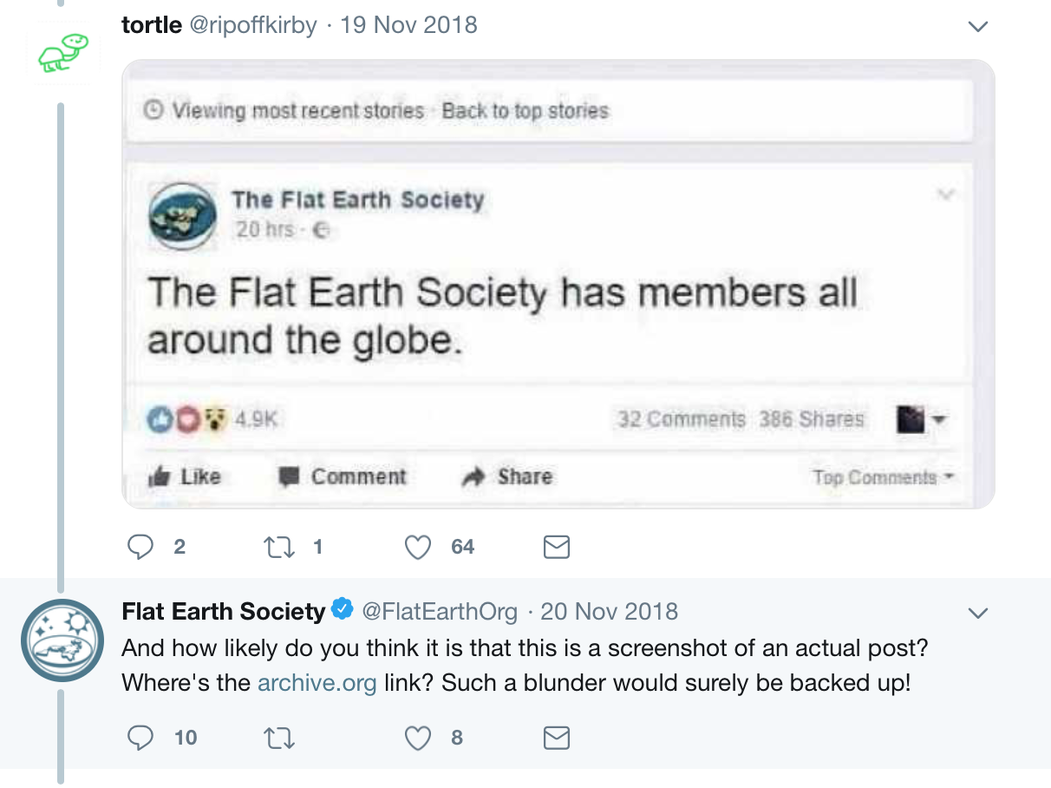
FES response: where is the evidence?
https://twitter.com/FlatEarthOrg/status/1064805779260284928

Slide 26
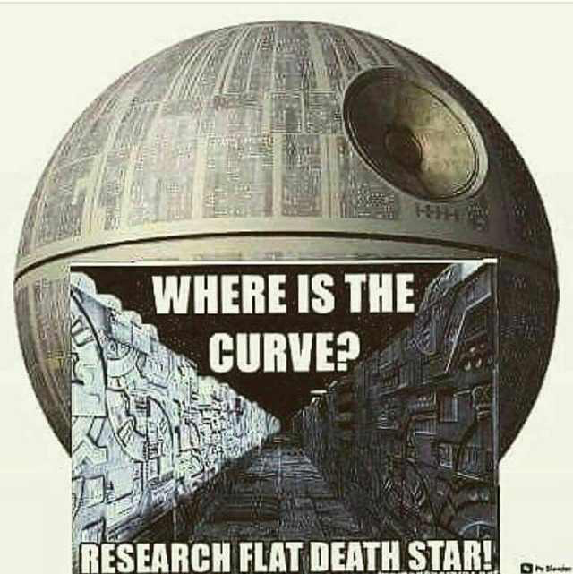
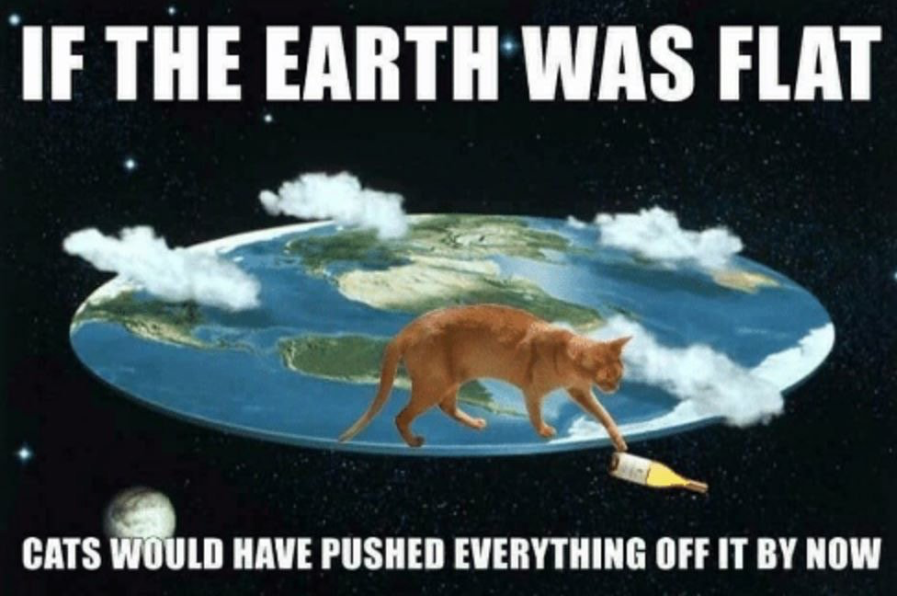
Takeaway

